Slide 1
Lecture 3:
Implementing Class Association in Java

Slide 2
Association Exercise 1
Develop class model: A Person works for a Company. A Company is the employer of one person.
Role
Implicit attribute of Company
Implicit attribute of Person
Person
Company
employee
employer
1
works for
1
Association Name
Write Code
Observe: Bidirectional navigation.
Implement in Java…

Slide 3
Exercise 1: Solution
public class Company {
private Person employee;
public void employPerson(Person p){
employee=p;
p.setCompany(this);
}
public class Person {
private Company employer;
public Company getWorksFor() {
return employer;
}
public void setCompany(Company c) {
employer=c;
}
}

Slide 4
1-1 Association: Example 3
1
has
1
Advertiser
Account
public class Advertiser {
private Account account;
public Advertiser() {
account = new Account(this);
}
public Account getAccount() {
return account;
}
}
Write code for Advertiser
Now, Write code for Account
Notes:
If Advertiser accesses only Account, but not vice versa, the class Account can be made a local attribute in the Advertiser class

Slide 5
1-1 Association
Advertiser
1
1
Account
public class Advertiser {
private Account account;
public Advertiser() {
account = new Account(this);
}
public Account getAccount() {
return account;
}
}
public class Account {
private Advertiser owner;
publicAccount(Advertiser owner) {
this.owner = owner;
}
public Advertiser getOwner() {
return owner;
}
}

Slide 6
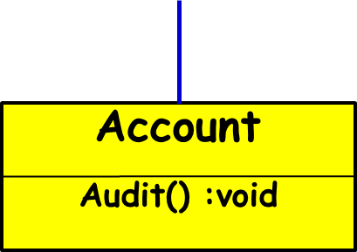
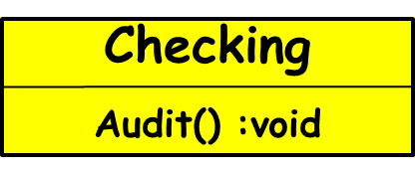
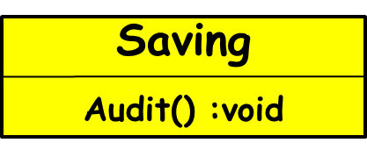
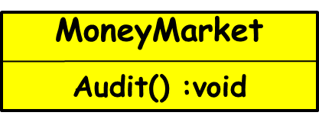
Quiz: Read Banking System Class Model
Bank
1
has
*
A Bank has many Accounts
Checking, Savings, MoneyMarket are Account types

Slide 7
Quiz: Read UML class diagram
has
CPU
Controller
1
0..2
1..4
1
DiskDrive
SCSIController
controls
A CPU has upto two Controllers
SCSIController is a special type of Controller
A SCSIController controls 1-4 DiskDrives

Slide 8
Java Code?
CPU
has
Controller
1
*
  class CPU {
  Controller [ ] myCtlrs=new Controller[100]; ???
  }
  class Controller {
  CPU myCPU;
  }
  class SCSIController extends Controller {
  DiskDrive [ ] myDrives= new DiskDrive[4];
  }
  Class DiskDrive {
  SCSIController mySCSI;
  }
1..4
1
DiskDrive
SCSIController
controls

Slide 9
Implementing Association Multiplicities
Fixed multiplicity:
The reference field can be
Book [] book=new Book[10];.
When the upper end is *:
  Java collections need to be used
  Collections facility was added to Java as a part of JDK 1.2
Member
1
Book
Borrowed
by
1..10

Slide 10


Slide 11
Java Collections
When association-end multiplicities is *, need to use Collections.
Collections were added to Java as part of JDK 1.2
Operations supported:
  Add
  Remove
  Access individual objects (Iterators)

Slide 12
Java Collections
Java collections are of three basic types:
  List (Ordered)
  Set (Unordered)
  Map (Key-value pairs)

Slide 13
Bit of History…
Pre Java SDK1.2, Java provided a handful of data structures:
  Hashtable
  Vector
  Bitset
These were for the most part good and easy to use:
  But were not organized into a general framework.
In SDK1.2 legacy data structures retrofitted to new model.

Slide 14
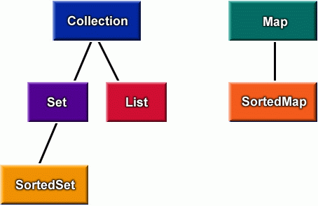
Java Collections

Slide 15
«interface»
Collection
«interface»
Map
«interface»
Set
«interface»
List
«interface»
Queue
«interface»
SortedMap
HashSet
«interface»
SortedSet
Vector
ArrayList
LinkedList
TreeMap
HashMap
Linked
HashSet
TreeSet

Slide 16
Java Collections: What is it?
“The Collections Framework provides a well-designed set of interfaces and classes for storing and manipulating groups of data as a single unit, a collection.”
-java.sun.com

Slide 17

Java Collections
 |  | Implementations
 |  | Hash Table | Resizable Array | Balanced Tree | Linked List
Interfaces | Set | HashSet |  | TreeSet
 | List |  | ArrayList |  | LinkedList
 | Map | HashMap |  | TreeMap

Slide 18
Three Basic Java Collections
List : Sequences
  Ordering is implicit
  it is legitimate to ask questions like “what is the first object in the sequence?”
  Add book as first book etc.
Sets: Unordered collection
Maps: Qualified associations
  Each entry involves a pair of objects.
  A map is also called as a dictionary.
  it is legitimate to ask questions like “what value - if any - is associated with the following key?” or
  “does this map contain the following key?”.
For all types of Collections:
  Can create an Iterator object to access each item in the collection once.

Slide 19
Which List to Use?
LinkedList:
  Good if the list changes size (grows or shrinks) frequently
  Good for accessing either end of the list, but slower when accessing items in the middle of the list
ArrayList:
  Good if accessing elements by specific position, but slow for adds and removes.

Slide 20
Vector class
In what ways different from ArrayList?
Similar to an ArrayList:
  but synchronized for multithreaded programming (hence slow).
Mainly for backward-compatibility with old java.
Used also as base class for Stack implementation.

Slide 21
Which Set to Use?
HashSet:
  Good efficiency in most cases
TreeSet:
  Useful when an iterator will access the elements of the set in a specific order based on their value (e.g. Strings would be kept in alphabetical order.)

Slide 22
Which Map to Use?
HashMap:
  Efficient in most cases
TreeMap:
  An iterator obtained from the key set can be used to access the elements of the map in key order.

Slide 23
Collection: Basic operations
int size( );
boolean isEmpty( );
boolean contains(Object element);
boolean add(Object element);
boolean remove(Object element);
Iterator iterator( );

Slide 24
Collection: Iterator
public interface Iterator {
boolean hasNext( );
  // true if there is another element
Object next( );
  // returns the next element (advances the iterator)
void remove( ); // Optional
// removes the element returned by next
}

Slide 25
ArrayList<String> languages = new ArrayList<>();
// Add elements in the array list
languages.add("Java");
languages.add("Python");
languages.add("JavaScript");
languages.add("Swift");
Iterator<String> iterate = languages.iterator();
while(iterate.hasNext()){
System.out.println(iterate.next());
}

Slide 26
Write Code for Association Multiplicity
class Customer{
private ArrayList <Account> accounts = new ArrayList<Account>();
public Customer() {
Account defaultAccount = new Account();
accounts.add(defaultAccount);
}
}
Customer
has
Account
1
1..*

Slide 27
HW: Write Code for Example Association Relationships
Library Member
Book
1
borrowed by
*
Employee
employed by
1
Company
*

Slide 28
Quiz 2: Draw UML Class Diagram
    public class TreeMap {
    TreeMapNode topNode = null;
    public void add(Comparable key, Object value) {…}
    public Object get(Comparable key) {…}
    }
    class TreeMapNode {
    private Comparable itsKey;
    private Object itsValue;
    private TreeMapNode[] nodes = new TreeMapNode[2];
    public TreeMapNode(Comparable key, Object value) {…}
    public Object find(Comparable key) {…}
    public void add(Comparable key, Object value) {…}
    }

Slide 29
Quiz 2: UML Class Diagram Solution
2
nodes
TreeMap
TreeMapNode
topNode
+ add(key,value)
+ get(key)
+ add(key,value)
+ find(key)
itsKey
<<interface>>
Comparable
itsValue
Object

Slide 30
Recapture:
Association
Implementation
public class Company {
private Person employee;
public void employ(Person p){
employee=p;
p.setCompany(this);}
}
Do you see any problems with this code?
public class Person {
private Company employer;
public Company getWorksFor() {
return employer;
}
public void setCompany(Company c) {
employer=c;
}
}
Company
1
works
1
Person
employer
employee
Caveat: Previous employee may still have link to company.

Slide 31
public class A{
private B b;
public boolean setB (B value ){
if ( this.b == value ) return false ;
B oldValue = this.b ;
this.b = value ;
if ( oldValue != null )
oldValue.setA ( null ) ;
if ( value != null)
value.setA ( this ) ;
return true ;
}
public B getB () { return this.b ; }
A
1
1
B
a1
b1
Problem
a2
b2
Corrected Code

